Slide 1
Service Proposal for SS & PS only
SP Number:
SP Title: Business Delivery - Upstream (BDU) Managed Services for U-ACE.
This Service Proposal is only valid for thirty (30) days from <DD-MMM-YY>. PETRONAS Digital Sdn Bhd reserves the rights to change the Service Proposal after the said thirty (30) days.
Internal

Slide 2


This Document Covers
01
02
03
04
INTRODUCTION
PROPOSED Service
SERVICES FINANCIALS
APPROVALS
1.1 Glossary
1.2 Background and
Objectives
1.3 Out of Scope
2.1 Scope
2.2 Services & Deliverables
2.3 Assumptions
2.4 Risk & Mitigation
2.5 Team Structure
2.6 Roles and Responsibilities
(PETRONAS Digital)
2.7 Roles and Responsibilities
(Business)
3.1 Budget
4.1 Service Proposal
Approval
APPENDICES
Internal

Slide 3
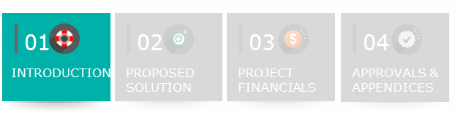
1.1 Glossary (1/2)
Terms / Abbreviations / Acronyms
Business Specific – Support Services | Pure Support services where the incident ticket is raised from ITSM (myGenie) and the scope of services only involves bug fixing and resolving technical issues of the product or application Support Services to be performed according to the agreed scope, plan, cost estimates and specifications, whereby PDSB is engaged by PETRONAS or PETRONAS Group Companies based on terms agreed in the SP
Business Specific – Product & Service Subscription | Product & Service Subscription is a service that encompasses the following criteria: 1. Product Purchasing: Involves the purchase of new software/application licenses or the renewal of existing software/application license or a combination of both. 2. Product & Service Subscription: Is a subscription service where the user may subscribe to products or services with specific functionalities or capabilities
Internal

Slide 4
1.1 Glossary (2/2)
Terms / Abbreviations / Acronyms
AppCentre | Refers to the Digital & ICT Service Portal, which offers SS and PS services. Service requisitions can be made through this portal
GFS | Group Financial Services (GFS)
OPE | Out-of-Pocket Expenses. The budget category used for travel and expense claim, FOREX, additional PTR review administration charges and miscellaneous expenses subject to Business approval such as utilities, refreshment, OLAR (Overtime Lamp and Air- Conditioner Request Services), printing and stationaries.
PTR | Project Transaction Report
SP | Service Proposal
Internal

Slide 5
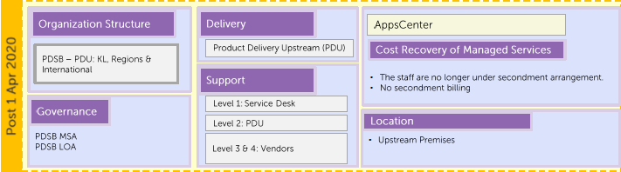
1.2 Background and Objectives
This Support Services request is driven by Product Delivery Upstream (PDU) for Upstream Technology, Digital & Innovation (UTDI).
Background
Effective 1 April 2020, the Product Delivery Upstream (PDU) was established as a dedicated entity under Upstream, mandated to support the Upstream Business’s Digital and ICT delivery and operational needs. Based within Upstream’s premises, PDU’s repositioning under PDSB aims to ensure seamless service continuity while upholding established operational standards.
This service request is a continuation of previous PDU Managed Services FY2024 AppCentre Order Item Number 3825458.
Solution Proposal is developed to support PDU in executing its service responsibilities. The scope of work and related activities have been carefully reviewed to ensure alignment with all relevant stakeholders.
The proposed solution is designed to span a full calendar year, commencing in January and concluding in December 2025
Internal

Slide 6
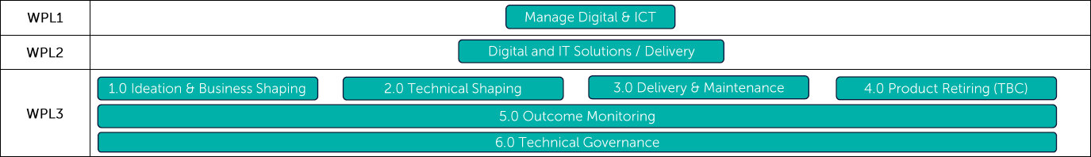
1.2 Background and Objectives
This Support Services request is driven by Business Delivery - Upstream (BD) for Upstream Technology, Digital & Innovation (UTDI).
Background
Effective 1st March 2026, the PDSB Business Delivery - Upstream (BD) was established as a dedicated entity under Upstream, mandated to support the Upstream Business’s Digital and ICT delivery and operational needs. Based within Upstream’s premises, BD’s repositioning under PDSB aims to ensure seamless service continuity while upholding established operational standards.
Solution Proposal is developed to support Business Digital Unit (Upstream) in executing its service responsibilities. The scope of work and related activities are to ensure BD - Joint Development Agreement (JDA) initiatives (Build by Externals) are aligned with PDSB Digital and ICT Work Process.
JDA 1 - Accelerate HC Discovery
JDA 2 - Maximize Asset Value Subsurface
JDA 3 -Maximize Asset Value Surface
JDA 4- Accelerate HC Monetization
In addition to support BDU in executing its service responsibilities. The scope of work and related activities have been carefully reviewed to ensure alignment with all relevant stakeholders.
2026 Digital & ICT Work Process
Internal

Slide 7
1.3 Out of Scope
No | Descriptions
1 | Hardware or Software that is directly procured by Business and not through PETRONAS Digital, the support and maintenance are undertaken by the Business.
2 | Training is out of the scope of this SP.
3 | Contract that is manages by the Business.
4 | Any other related activities that fall outside the scope and responsibility of the BD Upstream.
Internal
Notes:
Highly recommend to use with application architecture slide and user group in order the Service meet the requirement as stated in BRS and solving the business challenges and gaps. A more detailed process flow can be capture in System Requirement Specification (SRS).

Slide 8
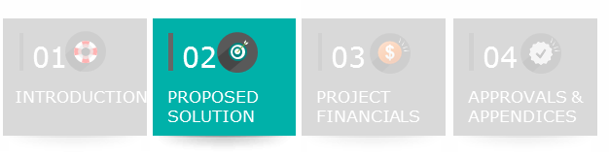
2.1 Scope
No | Scope
1 | To formalized PDU Managed Services between PDSB and UTDI 001
2 | UTDI 001 will be invoiced once a year in 2025 (Lump for Q1-Q4)
3 | PDU personnel will remain stationed at the Upstream Workspace/Premises to continue delivering services and support to the Upstream Business
Internal
Notes:
Highly recommend to use with application architecture slide and user group in order the Service meet the requirement as stated in BRS and solving the business challenges and gaps. A more detailed process flow can be capture in System Requirement Specification (SRS).

Slide 9
2.1 Scope
No | Scope
1 | To support BDU’s Joint Agreement Development (JDA 1, 2, 3 and 4) initiatives, ensuring relevant artifacts are prepared based on Digital & ICT Work process requirements with the accountability on BDU Solution Lead.
2 | To provide additional support to BDU Solution Leads in 2026/2027 requests Ideation & Business Shaping tasks focusing on Upstream Flagship and Non-Flagship initiatives. (Support & Maintenance, Infra request, Technical Evaluation and Business Excellence requests) with the accountability on BDU Solution Lead.
3 | To support BDU’s Joint Agreement Development (JDA 1, 2, 3 and 4) initiatives, ensuring PDSB Technical requirements are prepared based on EA Technical Assessments​ in preparation to scale the solutions, to be guided by PDSB Solution Architects.
Internal
Notes:
Highly recommend to use with application architecture slide and user group in order the Service meet the requirement as stated in BRS and solving the business challenges and gaps. A more detailed process flow can be capture in System Requirement Specification (SRS).

Slide 10
Upstream 2026 Managed Service Cost
Upstream Flagship initiatives cost (34 Demands)
Tribe | Flagship Count | Average FTE/Month Jul - Dec | Total (RM)
Decarbonisation & Business Excellence | 12 | 1.75 | 292,743
Production | 8 | 1 | 233,377
Exploration | 2 | 0.5 | 94,347
Development | 12 | 1.75 | 292,743
Total | 34 | 5.0 | 1,082,202
Upstream Flagship initiatives cost (34 Demands)
Proposed resources are to provide additional support to assist Solution Leads as per Digital Work & ICT Process
Upstream Non-Flagship initiative cost (Remaining Demands)
Tribe | Average FTE/Month Jul - Dec | Total (RM)
Decarbonisation & Business Excellence | 3.5 | 585,468
Production | 2.5 | 396,792
Exploration | 1.5 | 188,694
Development | 1 | 446,754
Solution Architect | 1.5 | 178,992
Total | 8.5 | 1,796,700
Upstream Non-Flagship initiative cost (Remaining Demands)
Proposed resources are to completed the tasks as per Digital Work & ICT Process for Non Flagship related SRs, Support Services Request or Infra Requests with Solution Lead in line of sight.
Grand Total RM 2,699,928

Slide 11
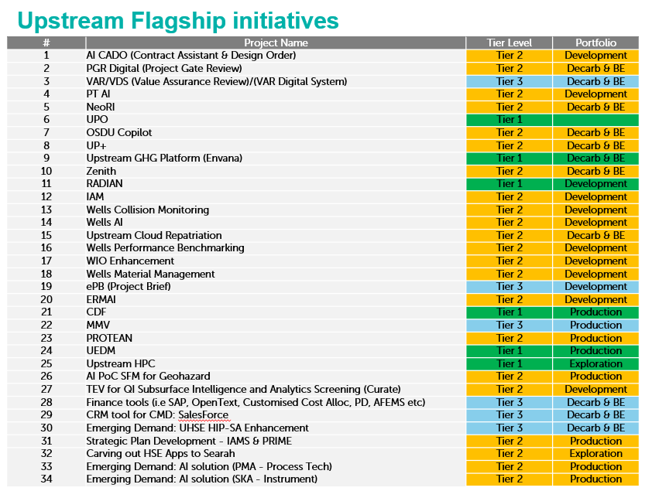
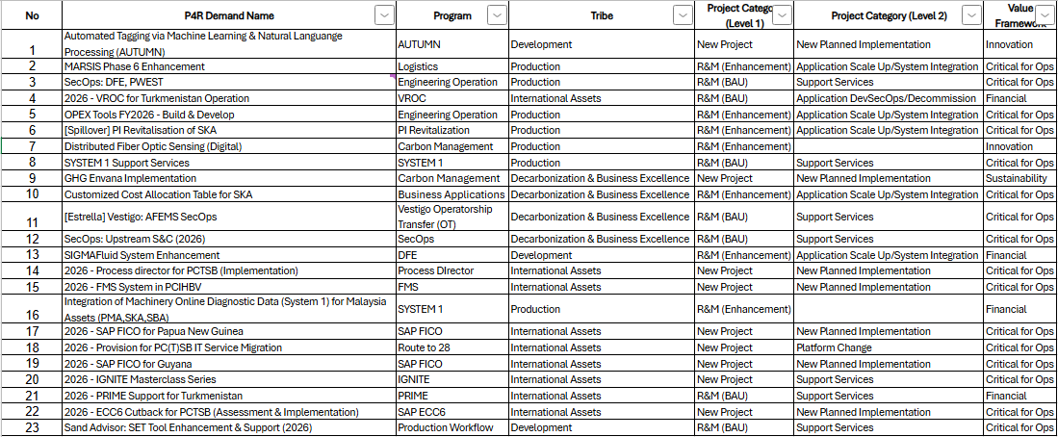
Ideation & Business Shaping
Tier 1, 2, 3 Flagship Demands
Ideation & Biz Shaping
RACI
Solution Lead – Accountable
Business Domain Analyst - Responsible
Request Type
Exploration
Development
Production
Decarb & Business Excellence
Tier 2 or 3
Request Tier
Other Demands
Identified as Flagship Demands
Non-Flagship Demands
Support & Maintenance / Infra Demand
Ideation & Biz Shaping
RACI
Solution Lead – Informed/Consult
Business Domain Analyst – Accountable/Responsible
TEV Request
*Including FY2027 demands approx. 150 SCBs to be produced in Q4 2026

Slide 12
Flagship Demands
Ideation & Business Shaping
Technical Shaping
 | Stage
Role | PGR 1 Stakeholder Endorsement | Idea intake (Shaping) Solution alignment Assessment Solution Concept Brief (SCB) | PGR 2 Cadence + Technical Assessment | PGR 3 Sanction Memo by AA
Solution Lead | Accountable | Accountable | Accountable | Accountable
Business Domain Analyst | Responsible | Responsible | Responsible | Consult
RACI
Solution Lead – Accountable
Business Domain Analyst - Responsible

Slide 13
Non-Flagship Demands
Ideation & Business Shaping
Technical Shaping
 | Stage
Role | PGR 1 Stakeholder Endorsement | Idea intake (Shaping) Solution alignment Assessment Solution Concept Brief (SCB) | PGR 2 Cadence + Technical Assessment | PGR 3 Sanction Memo by AA
Solution Lead | Informed/Consult | Informed/Consult | Informed/Consult | Informed/Consult
Business Domain Analyst | Accountable | Accountable | Accountable | Accountable
*With line of sight from Solution Leads
RACI
Solution Lead – Informed/Consult
Business Domain Analyst – Accountable/Responsible

Slide 14
2.5 Team Structure
Business Delivery – Upstream
Head of BDUM
Faizal Zainol Alam
Business Project Sponsor
Head of U-ACE
Ina Czarina Bt Arief Tham
Exploration Tribe Lead
Muthu Kumar Sockalingam
Solution Lead 1
Development Tribe Lead
Nur Shida Che Zakaria
Solution Lead 2
Business Delivery – Upstream
BDUM Focal
Lim Hoong Keng
Production Tribe Lead
Abdul Halim Mat Noh
Solution Lead 3
M Agos Abul Hasan Asari
Business focal
International Tribe Lead
M Muaz Ali
Solution Lead 4
Decarbonization & Business Excellence Tribe Lead
Alan Teng
Solution Lead 5
Solution Architects
Business Domain Analysts
Legend:
PETRONAS Digital
Business
Internal

Slide 15
Upstream Flagship initiatives
# | Project Name | Tier Level | Portfolio
1 | AI CADO (Contract Assistant & Design Order) | Tier 2 | Development
2 | PGR Digital (Project Gate Review) | Tier 2 | Decarb & BE
3 | VAR/VDS (Value Assurance Review)/(VAR Digital System) | Tier 3 | Decarb & BE
4 | PT AI | Tier 2 | Development
5 | NeoRI | Tier 2 | Decarb & BE
6 | UPO | Tier 1
7 | OSDU Copilot | Tier 2 | Decarb & BE
8 | UP+ | Tier 2 | Decarb & BE
9 | Upstream GHG Platform (Envana) | Tier 1 | Decarb & BE
10 | Zenith | Tier 2 | Decarb & BE
11 | RADIAN | Tier 1 | Development
12 | IAM | Tier 2 | Development
13 | Wells Collision Monitoring | Tier 2 | Development
14 | Wells AI | Tier 2 | Development
15 | Upstream Cloud Repatriation | Tier 2 | Decarb & BE
16 | Wells Performance Benchmarking | Tier 2 | Development
17 | WIO Enhancement | Tier 2 | Development
18 | Wells Material Management | Tier 2 | Development
19 | ePB (Project Brief) | Tier 3 | Development
20 | ERMAI | Tier 2 | Development
21 | CDF | Tier 1 | Production
22 | MMV | Tier 3 | Production
23 | PROTEAN | Tier 2 | Production
24 | UEDM | Tier 1 | Production
25 | Upstream HPC | Tier 1 | Exploration
26 | AI PoC SFM for Geohazard | Tier 2 | Production
27 | TEV for QI Subsurface Intelligence and Analytics Screening (Curate) | Tier 2 | Development
28 | Finance tools (i.e SAP, OpenText, Customised Cost Alloc, PD, AFEMS etc) | Tier 3 | Decarb & BE
29 | CRM tool for CMD: SalesForce | Tier 3 | Decarb & BE
30 | Emerging Demand: UHSE HIP-SA Enhancement | Tier 3 | Decarb & BE
31 | Strategic Plan Development - IAMS & PRIME | Tier 2 | Production
32 | Carving out HSE Apps to Searah | Tier 2 | Exploration
33 | Emerging Demand: AI solution (PMA - Process Tech) | Tier 2 | Production
34 | Emerging Demand: AI solution (SKA - Instrument) | Tier 2 | Production

Slide 16
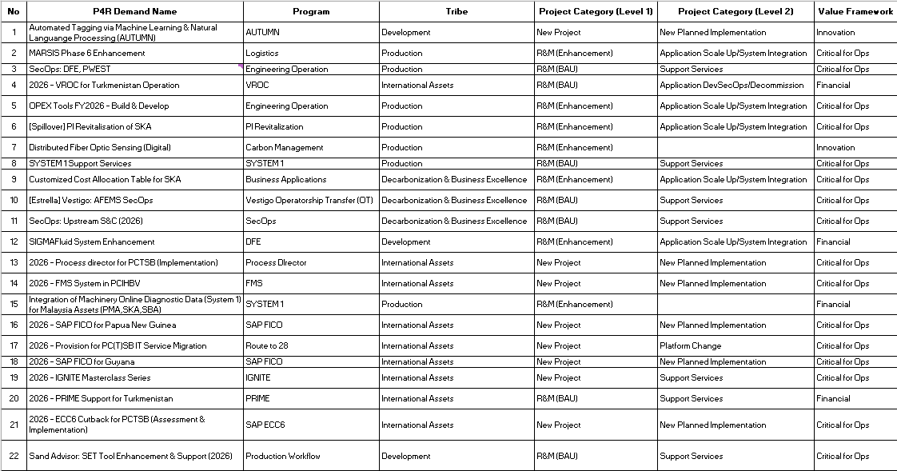
Upstream Non - Flagship initiatives

Slide 17
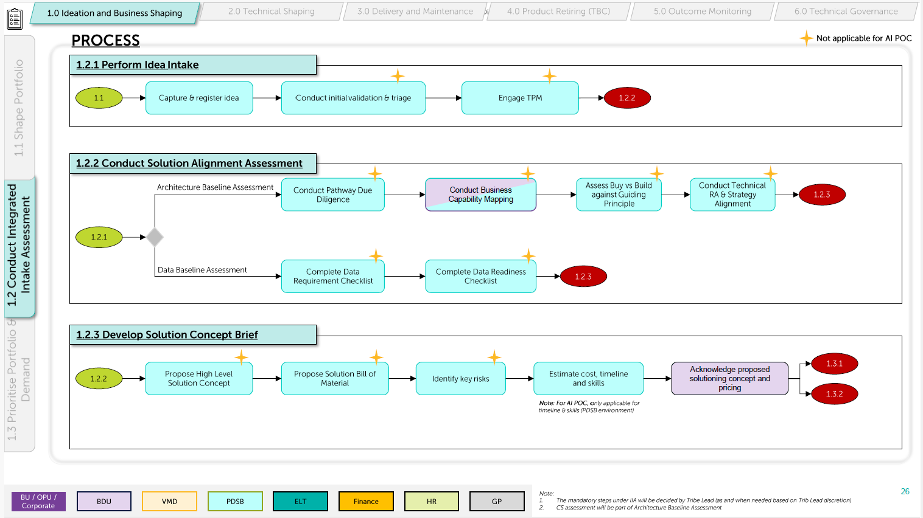
Flagship Demands
BDA will serve as an additional resource extension to manage the above tasks.
RACI
Solution Lead – Accountable
Business Domain Analyst - Responsible

Slide 18
Non-Flagship Demands
The Non-Flagship demands will be managed by BDA keeping Solution Leads in line of sight.
RACI
Solution Lead – Informed/Consult
Business Domain Analyst – Accountable/Responsible

Slide 19
Upstream 2027 Managed Service Cost
Upstream Flagship initiatives cost (~140 Demands)
Tribe | Average FTE/Month Jan - Dec | Total (RM)
Decarbonisation & Business Excellence | 3 | 1,379,070
Production | 2.25 | 1,220,934
Exploration | 1.5 | 843,546
Development | 2.25 | 1,270,896
International | 0.5 | 377,388
Solution Architect | 1 | 21,696.00
Total | 10.5 | 5,113,530
Grand Total RM 5,113,530
Note :
Proposed resources are to completed the tasks as per Digital Work & ICT Process for Non-Flagship related SRs, Support Services Request or Infra Requests with Solution Lead in line of sight.
Total 2027 Submitted Demands ~ 140 (reduction of 27 demands)

Slide 20
Planned New Demands (2027)
Portfolio | Total Demands
Development | 21
Production | 40
Exploration | 2
Decarbonisation & Business Excellence | 21
International Assets | 22
Malaysia Assets | xx
Total | ~106

Slide 21
Planned TEV request
NO | TRIBE | Total TEV FY2026 | Remarks
1 | EXP | 3 | 1. Mtracker 2. Curate 3. Wadugs
2 | DEV | 4 | 1. Well Collision 2. AI Cado 3. KPI Becnhmarking 4. Edge Gas Lift
3 | PROD | 3 | 1. Integrated Digital Solution for Upstream Logistic 2. PI 3. Marineset
4 | DBE | 0
5 | International Assets | 1 | 1. Premises Business Automation Tool for PCTSB

Slide 22
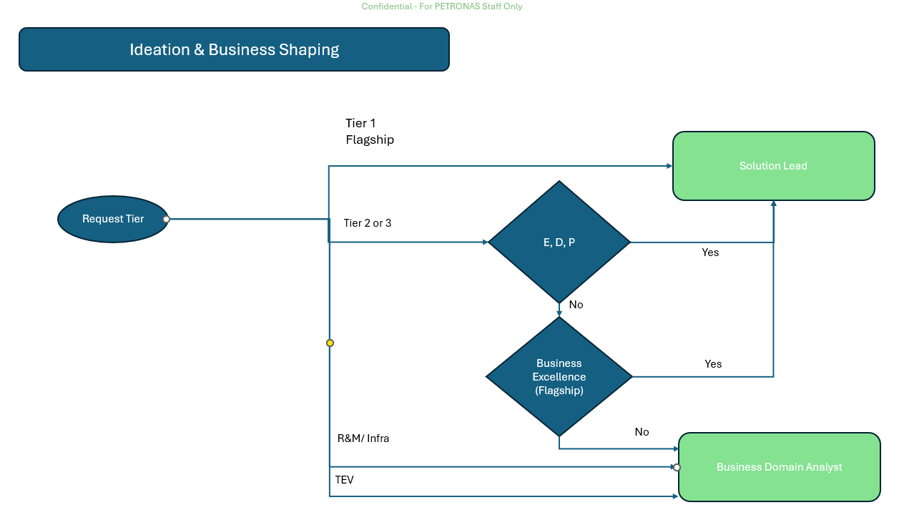
Flagship

Slide 23
2.2 Services & Deliverables – Product & Services Subscription
Service Schedule | Date | Goals | Key Deliverables/Activities
Support Services Start | January 2025 | Support Services started | Support Services
Cost Recovery | September 2025 December 2025 | Bill UTDI 001 once a year (lump) | Cost recovery will be done via GFS to Business Cost Center.
Closure | December 2025 | Support services closure | Closure activities
Internal
Notes:
Describe milestones in outcome-oriented language
Example: Release Goals – user will be able to accomplish x by end of Release 1.

Slide 24
2.2 Services & Deliverables – Product & Services Subscription
Service Schedule | Date | Goals | Key Deliverables/Activities
Support Services Start | July 2026 | Support Services started | Support Services
Closure | December 2026 | Support services closure | Closure activities
Internal
Notes:
Describe milestones in outcome-oriented language
Example: Release Goals – user will be able to accomplish x by end of Release 1.

Slide 25
2.3 Assumptions
No | Assumptions
1 | The planning and cost estimates presented will be revised as on required basis whenever updated by PDSB.
2 | The resources will be expected to actively participate in all aspects of the delivery and support services on a full-time basis.
3 | The cost recovery for this proposal is from January – December 2025.
Internal

Slide 26
2.4 Risk and Mitigation
No | Risk | Mitigation
1 | Not Applicable | Not Applicable
Internal

Slide 27
2.5 Team Structure
Business Delivery – Upstream
Head of BDUM
Faizal Zainol Alam
Business Project Sponsor
Head of UACE
Ina Czarina Bt Arief Tham
Business Focal
M Agos Abul Hasan Ashari
Business Delivery – Upstream
Tribe Leads
Nur Shida Che Zakaria (Development)
Abdul Halim Mat Noh (Production)
Ahmad Hassan Harun (Regulator)
Khairulniza Kamiso (Malaysia Assets)
Solution Leads 1
Solution Leads 2
Solution Leads 3
BDAs
BDAs
BDAs
Legend:
BDAs
PETRONAS Digital
Business
Internal

Slide 28
2.6 Roles and Responsibilities (PETRONAS Digital)
Manager – PDU EDPR Tech Apps Tribes
Role | Responsibilities
Oversee, direct, and supervise the implementation and execution of specialized technical and non-technical applications and infrastructure projects. Lead a hybrid DevOps team of IT engineers with domain expertise to deliver functional support across applications, workflows, and IT infrastructure for multidisciplinary EDPR. Drive strategic planning and execution of technical and business budgets, targets, and initiatives related to projects, applications, and workflows.
Planning and Budgeting
Manage and drive portfolio plans by internal stakeholders to assure the budgets areapproved and executed while maintaining day-to-day technical decision-makingprocess, in order to enhance the capability.
Contract Management & Vendor Management
Manage, advise and drive contracts to advance the business needs of Upstream andPETRONAS group at the best interest of the contract stakeholders.
Technical & Non-Technical Applications and Infrastructure Project Delivery
Lead and drive project implementation and execution for Upstream Technical & Non-Technical Application and Technical Infrastructure development projects domestic andglobally for Upstream business required by multi-disciplines in EDPR that maximizesvalue creation and return of investment holistically.
Technical & Non-Technical Application Functions & Workflow Support
Manage, drive and lead the technical specialized skilled technical domain staffs (EDPR)to provide hands-on technical system support on the technical and non-technicalapplications, functionalities and workflows in order to ensure business continuity andincrease end-user productivity by adding value for Upstream fraternity of users.
Internal

Slide 29
2.6 Roles and Responsibilities (PETRONAS Digital)
Executive – PDU EDPR Tech Apps Tribes
Role | Responsibilities
Deliver, Implement, execute and support the EDPR technical & non-technical applications functional & workflow and technical IT infrastructure, for Upstream multidisciplinary domain in order to respond timely and address integrated functional issues and fast-track the operations to respond and harvest the benefit realization required by multi-disciplines within the domain fraternity, in order to ensure consistent high-efficiency, availability & reliability of upstream technical & non-technical applications hence increasing technical & business users productivity and efficiency.
Portfolio Management
Execute service delivery of Upstream projects/program to meet Upstream Business expectations and requirements.
Delivery Excellence
Execute and facilitate end-to-end Upstream Projects activities for key projects and milestones.
Adopt, comply and enforce Upstream Projects with PDSB guidelines for project related.
Financial Management
Coordinate and manage the overall budget planning and utilization for the Upstream Project, while evaluating financial strategies to optimize costs and enhance project outcomes.
Internal

Slide 30
2.6 Roles and Responsibilities (PETRONAS Digital)
Manager – PDU Malaysia Assets
Role | Responsibilities
Oversee, direct, and supervise the implementation and execution of specialized technical and non-technical applications and infrastructure/telecommunication projects and maintenance activities. Drive strategic planning and execution of technical and business budgets, targets, and initiatives related to infrastructure, projects, applications, and workflows.
Planning and Budgeting
Manage and drive portfolio plans by internal stakeholders to assure the budgets are approved and executed while maintaining day-to-day technical decision-making process, in order to enhance the capability.
Contract Management & Vendor Management
Manage, advise and drive contracts to advance the business needs of Upstream and PETRONAS group at the best interest of the contract stakeholders.
Technical & Non-Technical Applications and Infrastructure Project Delivery
Lead and drive project implementation and execution for Upstream Technical & Non-Technical Application and Technical Infrastructure development projects domestic and globally for Upstream business required by multi-disciplines that maximizes value creation and return of investment holistically.
Technical & Non-Technical Application Functions & Workflow Support
Manage, drive and lead the technical specialized skilled technical domain staffs to provide hands-on technical system support on the technical and non-technical applications, functionalities and workflows in order to ensure business continuity and increase end-user productivity by adding value for Upstream fraternity of users.
IT Infrastructure & Telecommunication Support
Manage, drive and lead the technical specialized IT engineers support team to provide technical IT infrastructure support in order to ensure high availability of Technical IT infrastructure ensuring the maximum value of Upstream fraternity users.
Internal

Slide 31
2.6 Roles and Responsibilities (PETRONAS Digital)
Executive – PDU Malaysia Assets
Role | Responsibilities
Deliver, Implement, execute and support the technical & non-technical applications functional & workflow and technical IT infrastructure/telecommunication, for Upstream multidisciplinary domain in order to respond timely and address integrated functional issues and fast-track the operations to respond and harvest the benefit realization required by multi-disciplines within the domain fraternity, in order to ensure consistent high-efficiency, availability & reliability of upstream technical & non-technical applications and ICT infrastructure hence increasing technical & business users productivity and efficiency.
Portfolio Management
Execute service delivery of Upstream projects/program to meet Upstream Business expectations and requirements.
Delivery Excellence
Execute and facilitate end-to-end Upstream Projects activities for key projects and milestones.
Planning, budgeting, contract management, vendor management.
Adopt, comply and enforce Upstream Projects with PDSB guidelines for project related.
Financial Management
Coordinate and manage the overall budget planning and utilization for the Upstream Project, while evaluating financial strategies to optimize costs and enhance project outcomes.
IT Infrastructure & Telecommunication Support
Execute and facilitate the technical specialized IT engineers support team to provide technical IT infrastructure support in order to ensure high availability of Technical IT infrastructure ensuring the maximum value of Upstream fraternity users.
Internal

Slide 32
2.6 Roles and Responsibilities (PETRONAS Digital)
Executive – PDU EDPR Tribes
No. | Role | Responsibilities
1 | Service Owner | Lead and be accountable for identifying resources for 2S activities Manage and track the utilization of the budget for 2S activities
Internal

Slide 33
2.7 Roles and Responsibilities (Business)
The following is a list of the Business responsibilities. If these responsibilities are not met, PETRONAS Digital will advise Business in writing of the impact on the Plan and Charges.
Roles | Responsibilities
Business Team | Provide key information for identification of user requirements. Provide key information for the documentation of user practices, policies and procedures. Confirm user requirements. Provide key information for identification of gaps/issues. Confirm the approach and resolution for gaps/issues. Identify job and organization change resulting from the implementation and identify required user profiles and IDs. Document and user practices, policies and procedures.
Internal

Slide 34
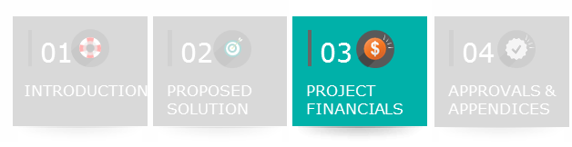
3.1 Budget
Commercial Arrangement: Fixed Price
The overall estimated Costs is [RM 2,477,767.59]
The estimated Business Specific Charges and the payment schedules are as follows:
Billable Cost Centre:001512-40B
*Billable cost centre referring to the Business WBS or cost centre
No. | Billing Schedule | Billing Frequency (Monthly/Quarterly/One off) | % | [A] Business Specific Charges (RM)
1 | FY2026 Billing – BDU Managed Services for UTD1 001 | One Off | 100 | 2,477,768
Total |  |  |  | 2,477,768
Internal

Slide 35
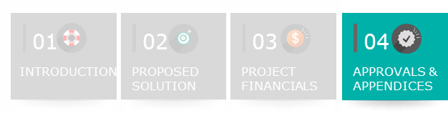

4.1 Service Proposal Approval
 | Name | Date
Prepared By (PDSB Service Owner) | Rabiatul Adawiyah Saad | 27-10-2025
Reviewed by | Khir Zainal Omar Shakri | 27-10-2025
APPROVAL INFORMATION
Name |  | Designation | Signature | Date
Approved By (PETRONAS Digital) | Ahmad Hassan B Harun | Senior Manager (Regulator Tribe) |  | 27-10-2025
Internal

Slide 36
Appendices
Internal

Slide 37
Details Budget Breakdown
Tribe | FTE | Total (RM)
Development | 2.23 | 553,831
Production | 1.30 | 211,818
Regulator | 5.12 | 1,213,509
Malaysia Assets | 1.61 | 424,230
Cybersecurity | 0.33 | 94,380
Total | 10.61 | 2,477,768
Internal

Slide 38
Details Budget Breakdown
Tribe | Pax | Mandays | Amount (RM)
Manager | 9 | 264 | 1,007,786
Executive | 17 | 264 | 1,469,982
Total | 26 |  | 2,477,768
Internal

Slide 39
Billing Information
 | Direct Billing / Business Specific Charges
Billing Approach | Invoiced by PETRONAS Digital to Business: Monthly for time & material basis. Billing Schedule for fixed price basis.
Payment | Paid by Business to PETRONAS Digital.
Estimated Billing Commencement | One month upon signing of SP and commencement of work on time & material basis. Upon first Billing Schedule signoff for fixed price basis.
Guideline Only. Please delete after use
[This slide Not to be removed.]
Internal

Slide 40
Thank you for your passion!
Internal

